Slide 1
Genomic evolution and epidemiological forecasting on PRRSV: Examples of our work
Igor Paploski, DVM, MSc, PhD
Department of Veterinary Population Medicine
University of Minnesota
Kimberly VanderWaal
Dennis Makau
Nakarin Pamornchainavakul
Julia Baker
João Herrera
Notes:
Hello, my name is Igor Paploski, thank you for being here today. My presentation contains results of research conducted by many members of the lab I’m part of, so let me take a minute to acknowledge them from the beginning. Kim VanderWaal is the PI on the lab, Dennis Makau is a post-doc, Son is a PhD candidate and Julia Baker is a PhD student.

Slide 2
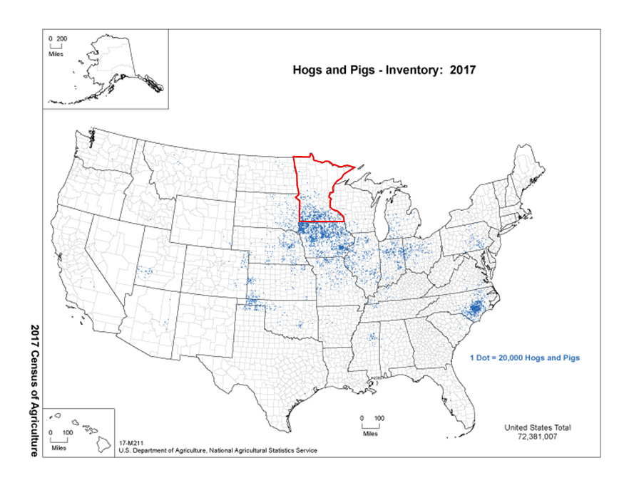
Minnesota swine industry and PRRSV
Part 1: Brief intro
Minnesota is the 2nd state in the US by hog inventory
>3,200 sites; >8 million heads; >15 million animals harvested each year; >U$3.3 billion in 2021
Porcine Reproductive and Respiratory Syndrome Virus
RNA virus that infects swine
>U$603 million in productivity losses annually (2013 data)
Genetic diversity of PRRSV is large and increasing

Slide 3
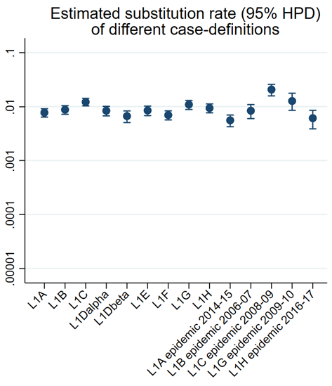
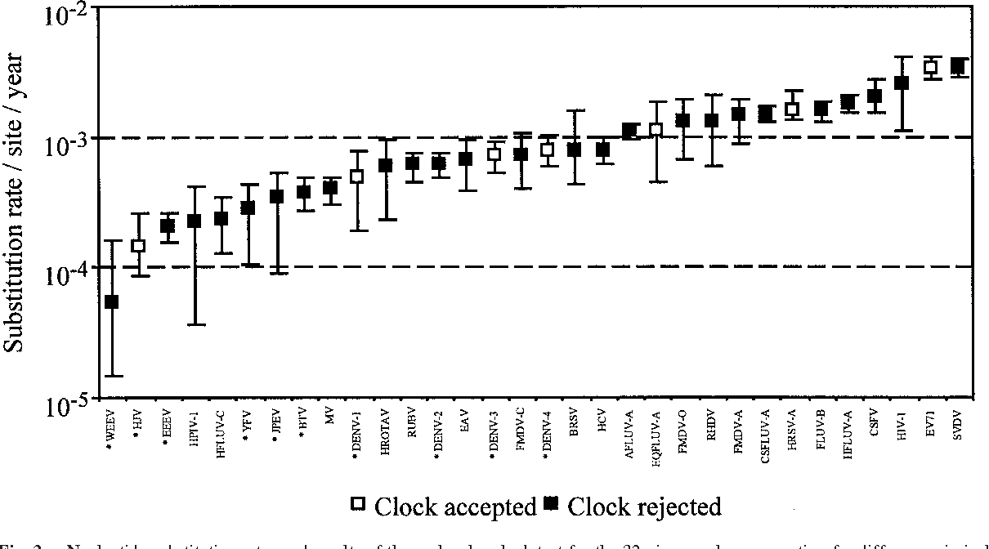
PRRSV is a genetically diverse virus
Part 2: PRRSV classification systems
PRRSV substitution rates are high even among RNA viruses
Evolutionary changes = genetic variability = antigenic variability
Variable cross-protection amongst heterologous strain
Like many viruses, PRRSV is incredibly diverse
Multi-strain dynamics
Several hypothesis on how strains emerge
Continuous emergence of new strains
Random mutation
Recombination
Immune selection
PRRSV Evolution in a complex landscape
Rates of Molecular Evolution in RNA Viruses: A Quantitative Phylogenetic Analysis
Notes:
PRRS is an extremely genetically diverse viruses. PRRSV has one of the highest substitution rates, even when compared with other RNA viruses, as yPRRS is an extremely genetically diverse viruses. PRRSV has one of the highest substitution rates, even when compared with other RNA viruses, as you can see in the figure in the left. This figure shows substitutions rates for several RNA viruses, while the right figure displays the substitution rates for several PRRS strains, both figures are at the same scale.
We care about this high substitution rate because this is one mechanism by which evolutionary changes occur, others being recombination and immune selection. All of those taken together leads to a complex landscape in which PRRSV evolve. This is important for us, because as I mentioned before, many strains of PRRSV exist – and the continuous emergence of new strains of PRRSV is a constant challenge for the swine industry. I’ll touch more on the point of continuous emergence of strains throughout the presentation.
ou can see in the figure in the left. This figure shows substitutions rates for several RNA viruses, while the right figure displays the substitution rates for several PRRS strains, both figures are at the same scale.
We care about this high substitution rate because this is one mechanism by which evolutionary changes occur, others being recombination and immune selection. All of those taken together leads to a complex landscape in which PRRSV evolve. This is important for us, because as I mentioned before, many strains of PRRSV exist – and the continuous emergence of new strains of PRRSV is a constant challenge for the swine industry. I’ll touch more on the point of continuous emergence of strains throughout the presentation.

Slide 4
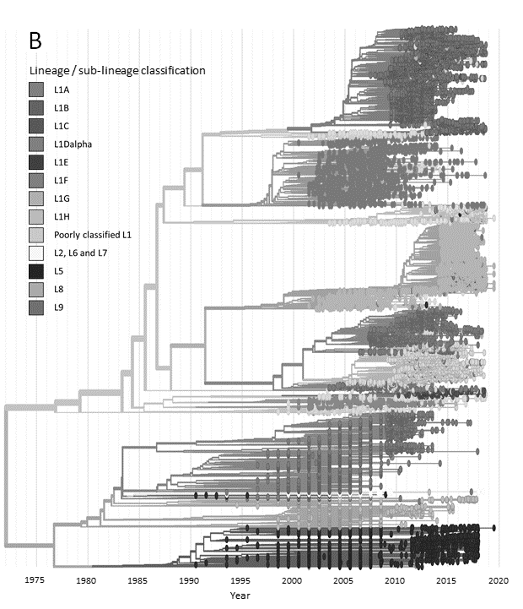
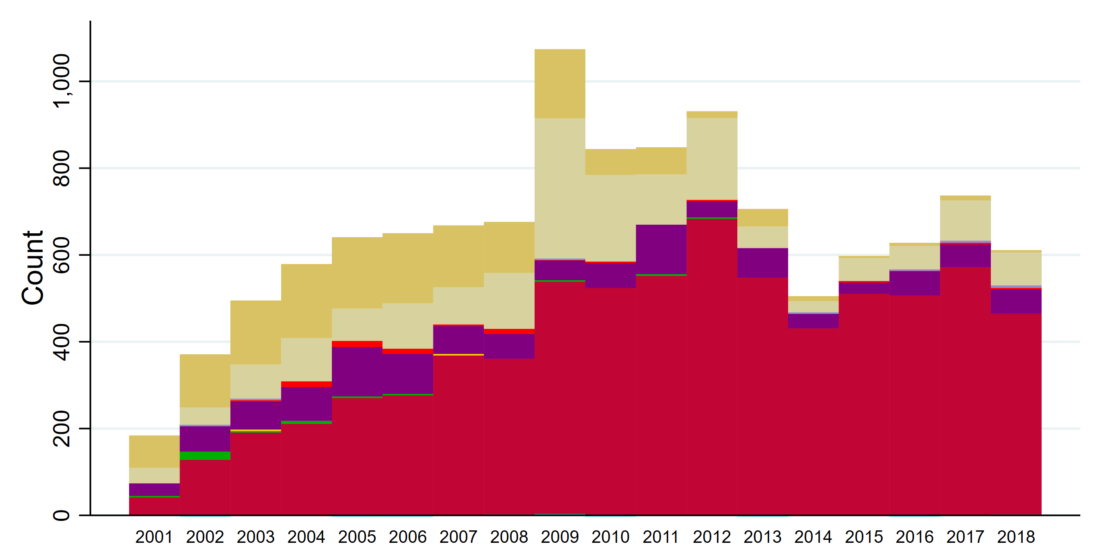
PRRSV lineage-based classification
Part 2: PRRSV classification systems
Between 2001 and 2018, 60% of all UMN VDL sequences were classified as Lineage 1
From 2013 onwards, >80%
Lineage 1
Vaccine
L8
L9
L1
1-2-2 (35%)
1-4-2 (30%)
1-4-2 (50%)
1-3-2 (41%)
2-5-2 (90%)
Frequency of occurrence per year, UMN VDL
Substructure within Lineage 1?
L9*
L8*
Shi et al. 2010, J. of Virology
*Paploski et al. 2019, Frontiers in Microbiology
Paploski et al. 2021, Vaccines
Yim-im et al. 2023, Microbiology Spectrum
L5*
Notes:
So we built the phylogenetic tree and it was evident that there was substructure even within Lineage 1.

Slide 5
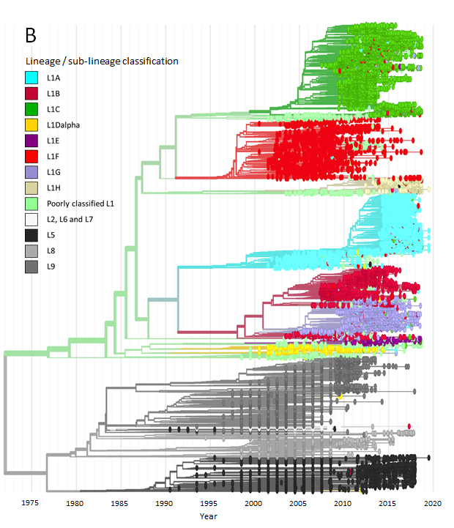
PRRSV lineage-based classification
Part 2: PRRSV classification systems
Between 2001 and 2018, 60% of all UMN VDL sequences were classified as Lineage 1
From 2013 onwards, >80%
Lineage 1
Vaccine
L8
L9
L1
1-2-2 (35%)
1-4-2 (30%)
1-4-2 (50%)
1-3-2 (41%)
2-5-2 (90%)
Frequency of occurrence per year, UMN VDL
Substructure within Lineage 1?
L9*
L8*
Shi et al. 2010, J. of Virology
*Paploski et al. 2019, Frontiers in Microbiology
Paploski et al. 2021, Vaccines
Yim-im et al. 2023, Microbiology Spectrum
L5*
Notes:
So if we go back to the prior slide and color the L1 of the tree according to sublineages, it makes the sub-lineage structure even more evident.

Slide 6
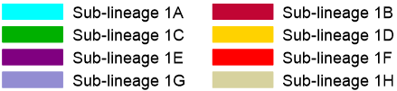
Sub-lineage emergence & Turnover
Part 2: Emergence of new sub-lineages
L1
1G
1H
1F
1C
1B
1A
Sub-lineages within Lineage 1 over time, UMN VDL
Estimated viral population size for different sub-lineages within Lineage 1 over time
Paploski et al. 2021
Viral population size inferred using coalescent Bayesian Skygrid analysis, BEAST v1.10.4
Notes:
So, if I take the epidemiologic curve of L1 occurrence and break that into sublineages, interesting patterns emerge.
1. Specific sub-lineages were more prevalent in certain time points;
2. certain sublineages emerged in the period our dataset was collected (such as sublineage 1C) and
3. other sublineages apparently increased their occurrence in the middle of the evaluated time, as happened with sublineage 1A.
However, a problem with relying on the count of sequences per sublineage only is that we are very dependent on sequencing efforts. If we look in 2014, for example, fewer sequence were obtained in that year. And why is that? This is the same year in which PED was introduced in the US, and caused an epidemic that diminished our capabilities of sequencing as much PRRS as we had in the previous years. So the number of sequences that we obtain in each year may not be the best way to estimate how prevalent that particular sub-lineage was in a given time point. In order to overcome that, we run an analysis in which we tried to estimated the viral population size based not only on sequence counts per time point, but also on how diverse were the sequences belonging to a certain sublineage in that time point. The rationale is that more diverse samplings were likely drawn from a larger population. As such, we came up with the figure on the right. Specific pattern can be seem, and I’m gonna discuss them in further slides.

Slide 7
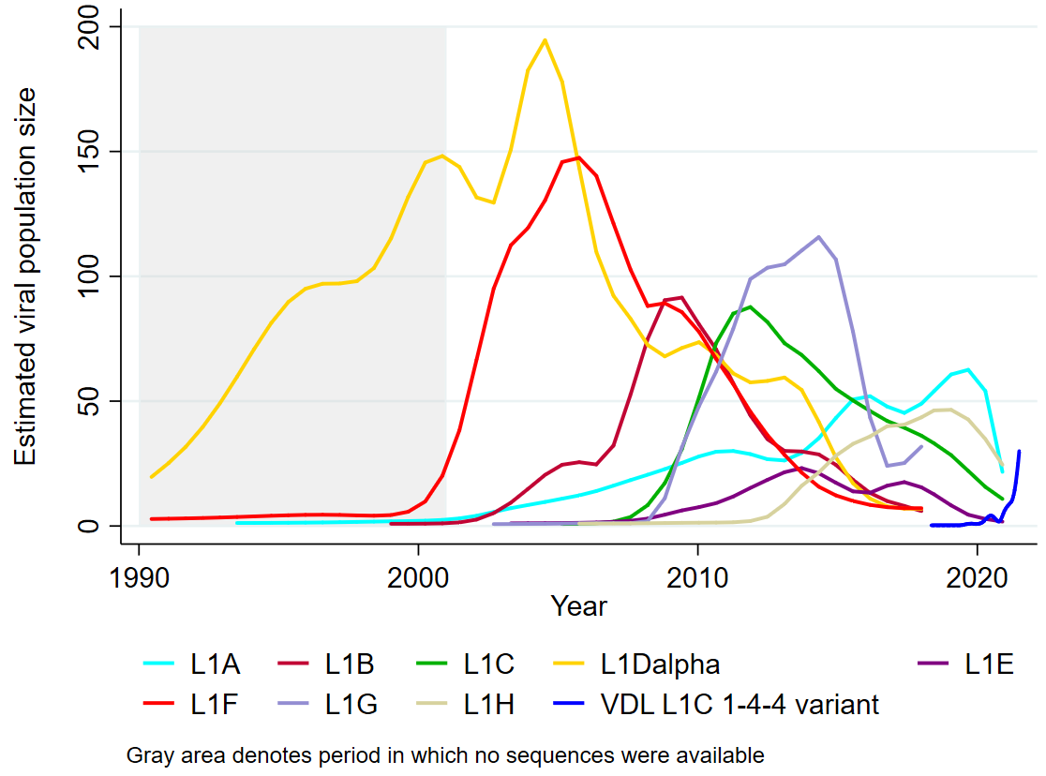








Sub-lineage emergence & Turnover
Part 2: Emergence of new sub-lineages
Sequential dominance of different sub-lineages
Years between peaks:
~3 years (median, range: 1-3)
Years emergence → dominance:
~4.5 years (median, range 2-6)
Years between sub-lineage emergence:
1-5 years (last emergence in 2014/2020)
1F
1G
1H
L5
L9
1C
1B
1A
Time of Peak
Paploski et al. 2021
Viral population size inferred using coalescent Bayesian Skygrid analysis, BEAST v1.10.4
Notes:
We can document the emergence and peak of different sublineages thourhg time, and we tried to display that in the figure in the bottom of the slide, showing when a sublineage began occurring and when we think that sublineage peaked. Interesting patters became evident. We saw the sequential dominance of different sublineages: we noticed the number of years between peaks was approximately 3 years; that the number of years elapsed since the emergence to the dominance of a certain sublineage was approxiamtelly 4.5 years and the the years between the emergence of new sublineages was between 1 and 5 years (with the last emergence in 2020, which I’m gonna discuss more about). All of those are interesting, because it allows us to understand a bit better the patterns of disease occurrence.

Slide 8
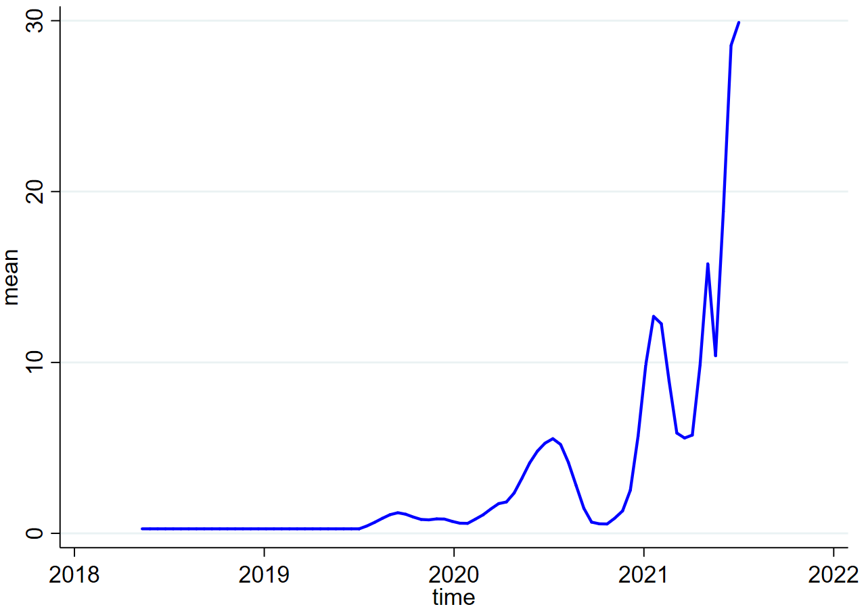
Sub-lineage emergence & Turnover
Part 2: Emergence of new sub-lineages
L1C 1-4-4 variant
Bursts of population size every ~6 months
VDL L1C 1-4-4 variant
???
1F
1G
1H
L5
L9
1C
1B
1A
L1C 1-4-4
variant
Time of Peak
Paploski et al. 2021
Viral population size inferred using coalescent Bayesian Skygrid analysis, BEAST v1.10.4
Notes:
So in 2020 we received reports of severe PRRS outbreaks occurring in farms and we obtained sequences from those outbreaks. When we repeated the previous analysis with sequences from this outbreak, we can see interesting patterns emerging. For example, we saw small bursts of viral population size every 6 months, which matches with the average age in which pigs are sent to slaughter. This new virus that we saw is being tentatively referred to as a “lineage 1c 1-4-4 variant”, and I will talk a bit more about it.

Slide 9
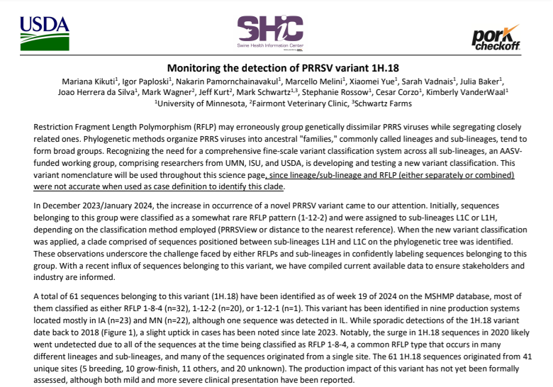
Emerging strains continue to cause issues
Part 2: Emergence of new sub-lineages
What is behind PRRSV strains emergence, and are there things we can do to better prepare the industry?
Notes:
So going back to the emergence of strains. The paper of the left discuss the emergence of the 1-7-4 virus, which many of you may have faced on your farms or systems. The figure on right describes the emergence of the L1C 1-4-4 virus in 2020, which was mostly restricted to the Midwest, and that many of you may also have faced it. Those two events illustrate the sort of problem that the frequent emergence of strains in PRRSV causes in the US, and we are trying to understand patterns behind these emergence events, with the ultimate goal of trying to prevent or better prepare the industry to face those events.

Slide 10
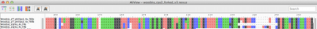
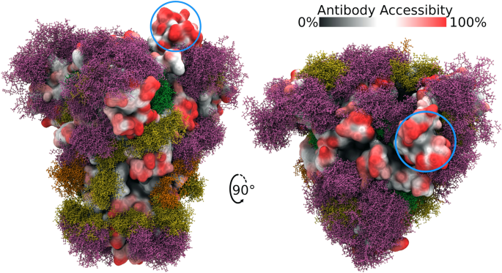
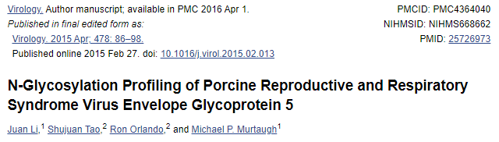
Glycosylation in GP5: could it provide insights?
Part 3: Glycosylation & phenotype
Glycosylation: a form of translational modification
Carbohydrate chains are added to proteins
Potentially affects protein folding
Changes protein sections that are exposed
Glycan shielding – shield portions of the protein that may be exposed to the host
Where does glycosylation occurs
on the GP5 protein?
Analysis of the SARS-CoV-2 spike protein glycan shield reveals implications for immune recognition; Grant, 2020.
Notes:
I mentioned before about glycosylated sites on the sub-lineages within lineage 1. Can we learn something by paying more attention to it? Let’s begin by quickly reviewing what glycosylation is. Glycosylation is a form of post-translational modification that proteins may go through after translation, in which carbohydrate chains are added to specific portions of proteins. These carbohydrate chains may change several properties of these proteins: how they fold, which portions of the protein are exposed. These carbohydrates added to proteins via glycosylation are involved in the glycan shielding, which essentially shields portions of the protein that may be exposed to the host, which ultimately changes the immune response elicited against these proteins. Glycosylation of proteins has been heavily studied, for example, on how it shapes the immune response elicited against the spike protein of SARS-COV-2. This is what the figure on the top right illustrates. It shows portions of the spike protein that are available to the host to mount the immune response against (shown in red) and the glycans added to the protein via glycosylation are the fuzzy molecules shown in purple, and these glycans block the immune response. Glycosylation has been studied on PRRS, but they don’t describe patterns of glycosylation across lineages.

Slide 11
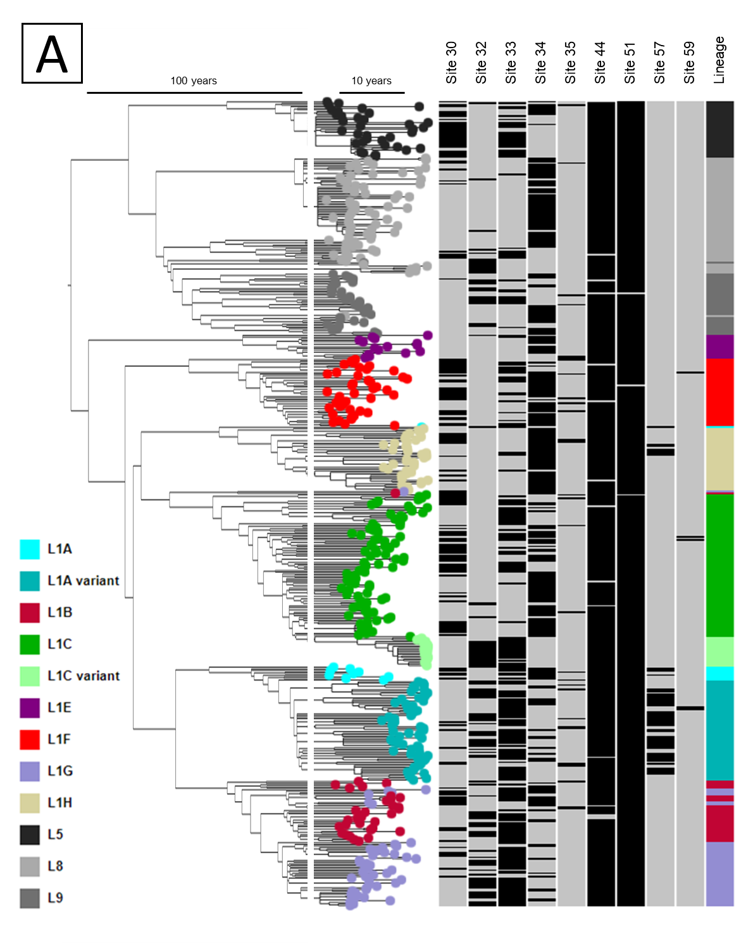
Glycosylation: interesting patterns
Part 3: Glycosylation & phenotype
ORF5 time-scaled tree with all sub-lineages
9/200 aminoacids on GP5 are potentially glycosylated in at least one sequence in the dataset
Most glycosylated sites are on the HVR
Flanks the Principal Neutralizing Epitope
Suggests that glycosylation may modulate the immune response elicited against the PNE portion of the GP5
Distinct glycosylation pattern of L1C 1-4-4 variant vs L1C
L1A 1-7-4: consistently glycosylated at site 57 - rare
Glycosylation patterns are not exclusive to certain L/SL
Glycosylation: not the only determinant of emergence
Can we estimate which variants of PRRSV will emerge?
Notes:
In order to better describe the glycosylation patterns seen we PRRS, we built an ORF5-only phylogenetic tree with examples of the most prevalent lineages and sublineages in the US, and this is what is shown on the tree on the right. It displays sequences from the UMN VDL that are colored according to the L and SL they belong. To the right of the tree you can see many bars, gray and black. Black boxes represent sequences that were glycosylated at that position, gray represent sequences that were not glycosylated at that position. Overall, we found that 9 sites on the GP5 protein are glycosylated, most of these sites are located on the HVR of the gene. This is what being highlighted now. The HVR flank the neutralizing epitope of the virus, and this suggests that glycosylation of these regions may modulate the immune response elicited against the principal neutralizing epitope of the GP5.
We can use this graph to highlight the glycosylation pattern of specific “variants” or “strains” of PRRSV that were important over time. For example, if we look at L1C and L1C 144, shown here in different shades of green, we can see that the L1C 144 virus had a distinct glycosylation patter as compared to other L1C virus, many of the sequences from this variant were glycosylated at sites 32 and 33, which are relatively particular to this variant.
Talking about the L1A 1-7-4 (shown in blue) virus, the glycosylation pattern of this virus was distinct to that seen in virtually all other PRRS viruses so far – site 57 is glycosylated almost exlusivelly on L1A 174 viruses.
However, overall the glycosylation patterns do not seem to be exclusive to certain L/SL, even though these remarkable examples can be pointed out.
But what about the occurrence of these glycosaylation patterns over time, can patterns be seen?

Slide 12

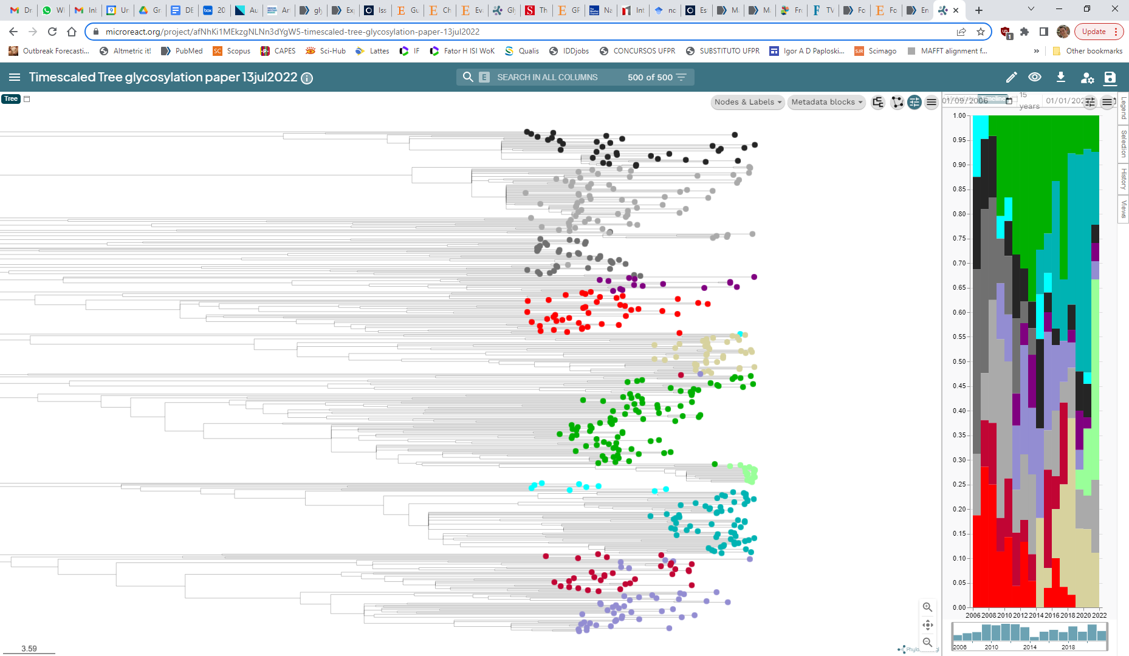
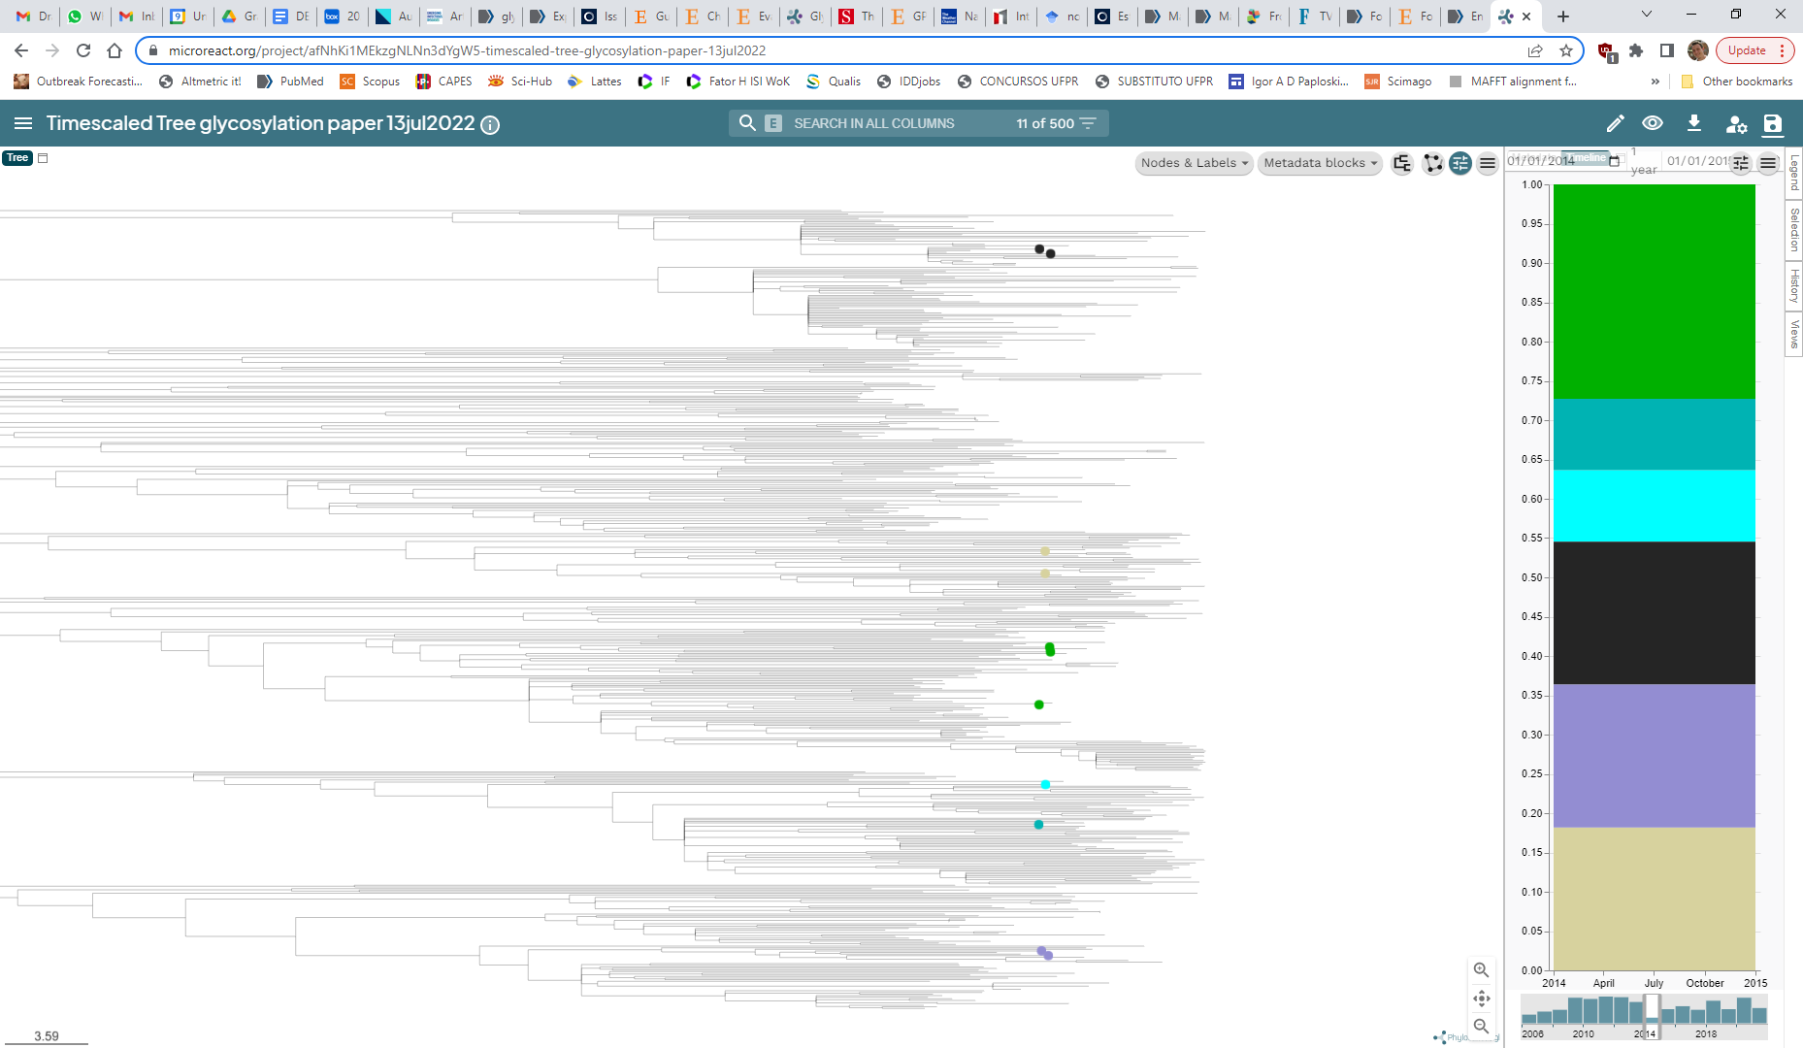
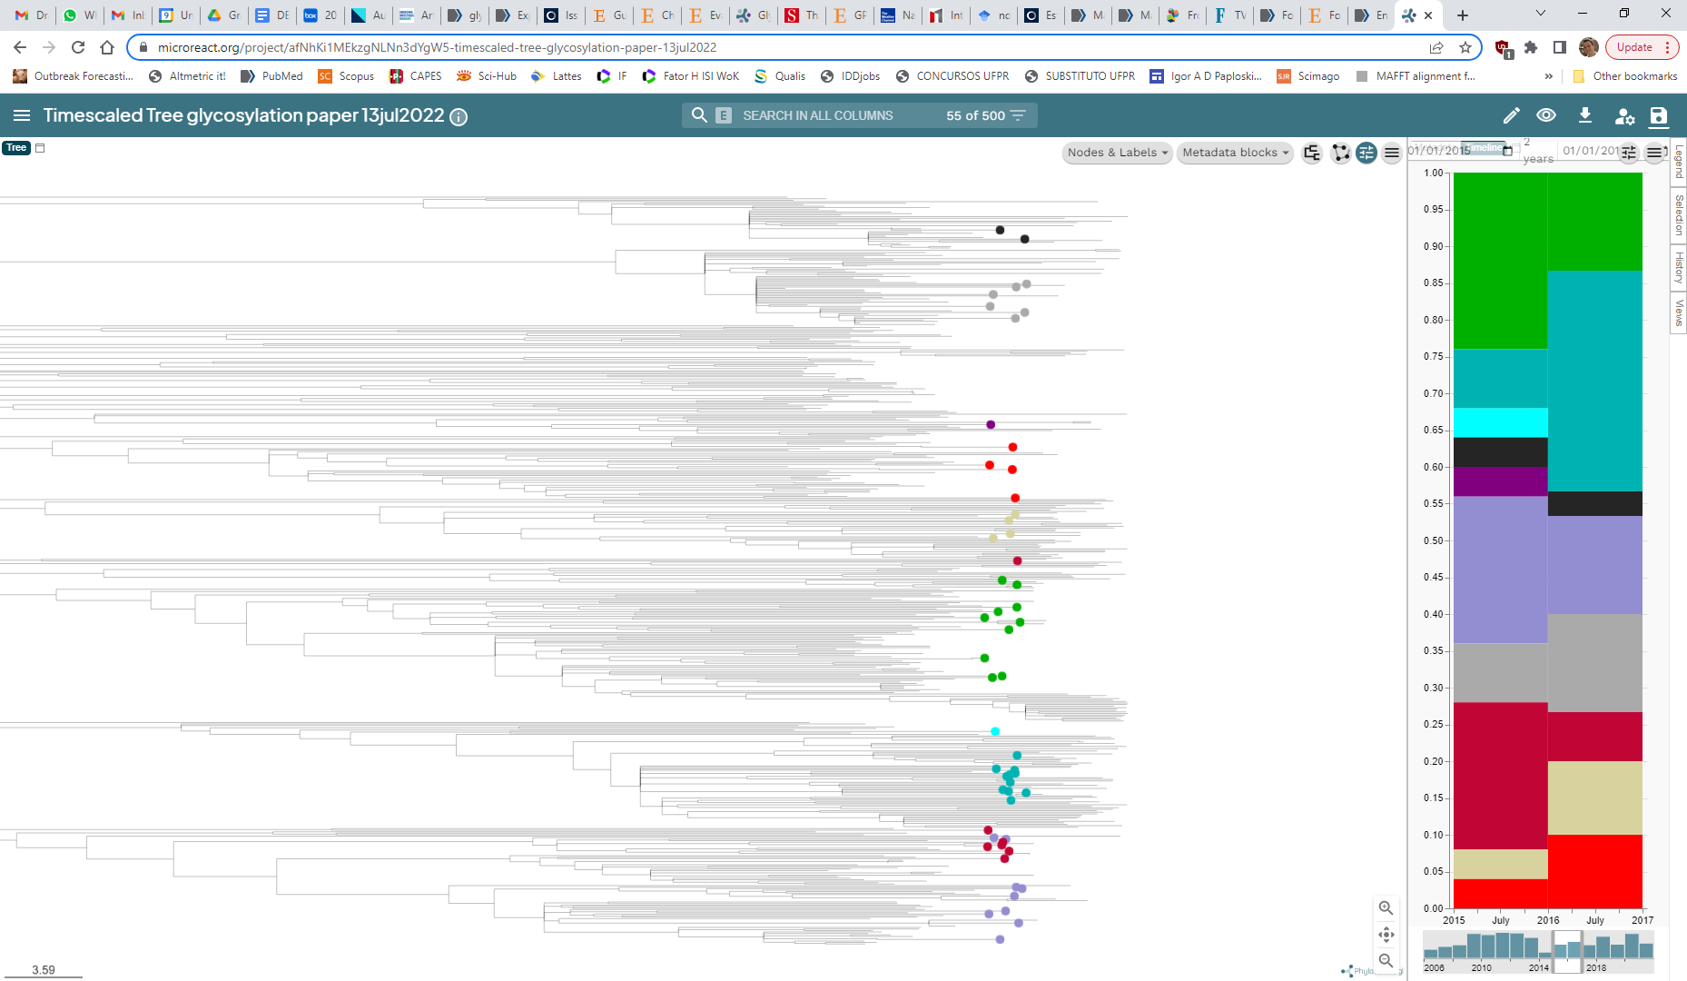
Early indicators of emergence potential
Part 4: Indicators of emergence potential
Pamornchainavakul
Wealth of genetic data routinely collected
Can we leverage…
available genetic data
state-of-the-art genetic data analysis tools
…to estimate a clade emergence potential?
Tree spanning 20 years of sequences
If we look at 2014 only…
…can we estimate which clades will be successful in 2015 and 2016?
Different sized windows of information and estimation of clade expansion can be used
Notes:
This is a work that a PhD candidate from our lab is doing, Nakarin Pamorchainavakul. He is trying to find early indicators of a strain emergence potential. Essentially, what he is trying to do is leverage the wealth of genetic data already available, that you collect and send to the UMN VDL, and by applying state of the art genetic data analysis tools, he is trying to evaluate the emergence potential of a clade. These figures on the right represent his approach. This is a part of a phylogenetic tree spanning 20 years of data. How we are posing this question is: if we look at a given year of data (2014, for example), can we estimate which clades will be successful in 2015 and 2016? And the size of these windows that we are looking at and that we are trying to evaluate the emergence potential are not fixed, the values here are simply an example.

Slide 13
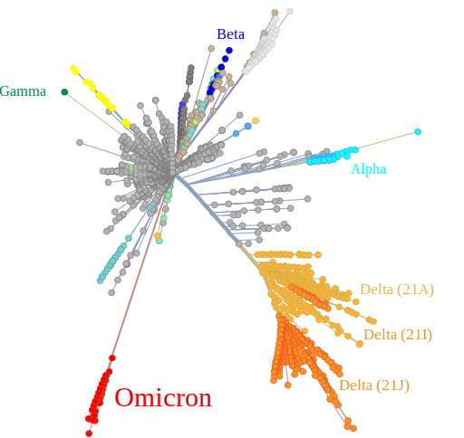
More distinct clades tend to expand more
Part 4: Indicators of emergence potential
The odds of emergence of a clade increase when:
More divergent from its ancestors
More distinct amino acid sequence as compared to the current most prevalent sequences
Glycosylation pattern are different compared to those found in currently most prevalent sequences
“Distinctiveness” of a clade likely plays a role on its fitness against current immunological background
Can we estimate how antigenically distinct PRRSV strains are?
Pamornchainavakul
Notes:
And what we found is that the more distinct clades tend to expand more – that’s the “importance of being different” that I alluded to on the outline of the presentation. We found that the odds of emergence of a PRRSV clade increase the more divergent that clade is when compared to its ancestors – and that’s what we are talking about. If we look at the figure on the right, which is on COVID, but it displays in black what we are referring to. The more divergent a clade is to its ancestors, the higher the odds of that clade expanding. We also found that the more distinct amino acid sequences and the more dissimilar the glycosylation pattern is when compared to the current most prevalent sequences, the higher the odds of a clade emerging.
These points taken together lead us to think that the “distinctiveness” of a clade likely play a role on its ability to thrive given the current immunological situation on the field.
If that is true, then can we estimate how antigenically distinct PRRSV strains are to one another?

Slide 14

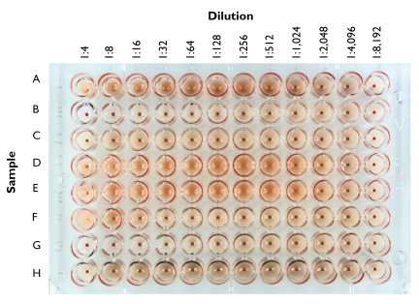
Can antigenic differences between PRRSV be estimated?
Part 5: Estimating antigenic differences
PRRSV serum exposed to other PRRSV strains
Titers estimated via dilution of the serum
Categorization of cross-reactivity
PRRSV1 only (so far)
Contrasting the estimated cross-neutralization against the viral genetic sequence
Using machine learning algorithms…
… can we identify genetic predictor of cross-neutralization between PRRS strains?
Makau
https://www.virology.ws/2009/05/27/
Hemagglutinin assay of Influenza
Notes:
So we decided to explore that! The extend of cross-neutralization between different strains of PRRSV can be estimated inoculating animals with one PRRSV strain, collecting serum from these animals and exposing it to other PRRSV strains. Then you measure how much the antibodies elicited against the first strain react against other viruses. By doing so, we categorized the immune response against ofther PRRSV strains into “low” and “high”. This analysis was only done for PRRSV1 so far – but we are beginning to repeat it for PRRSV2 currently.
So we have some measure of cross-reactivity, of antigenic differences between different strains of PRRS. What is I would say unique about our work is that we are trying to apply machine learning algorithms to identify genetic predictors of cross neutralization between PRRS strains.

Slide 15
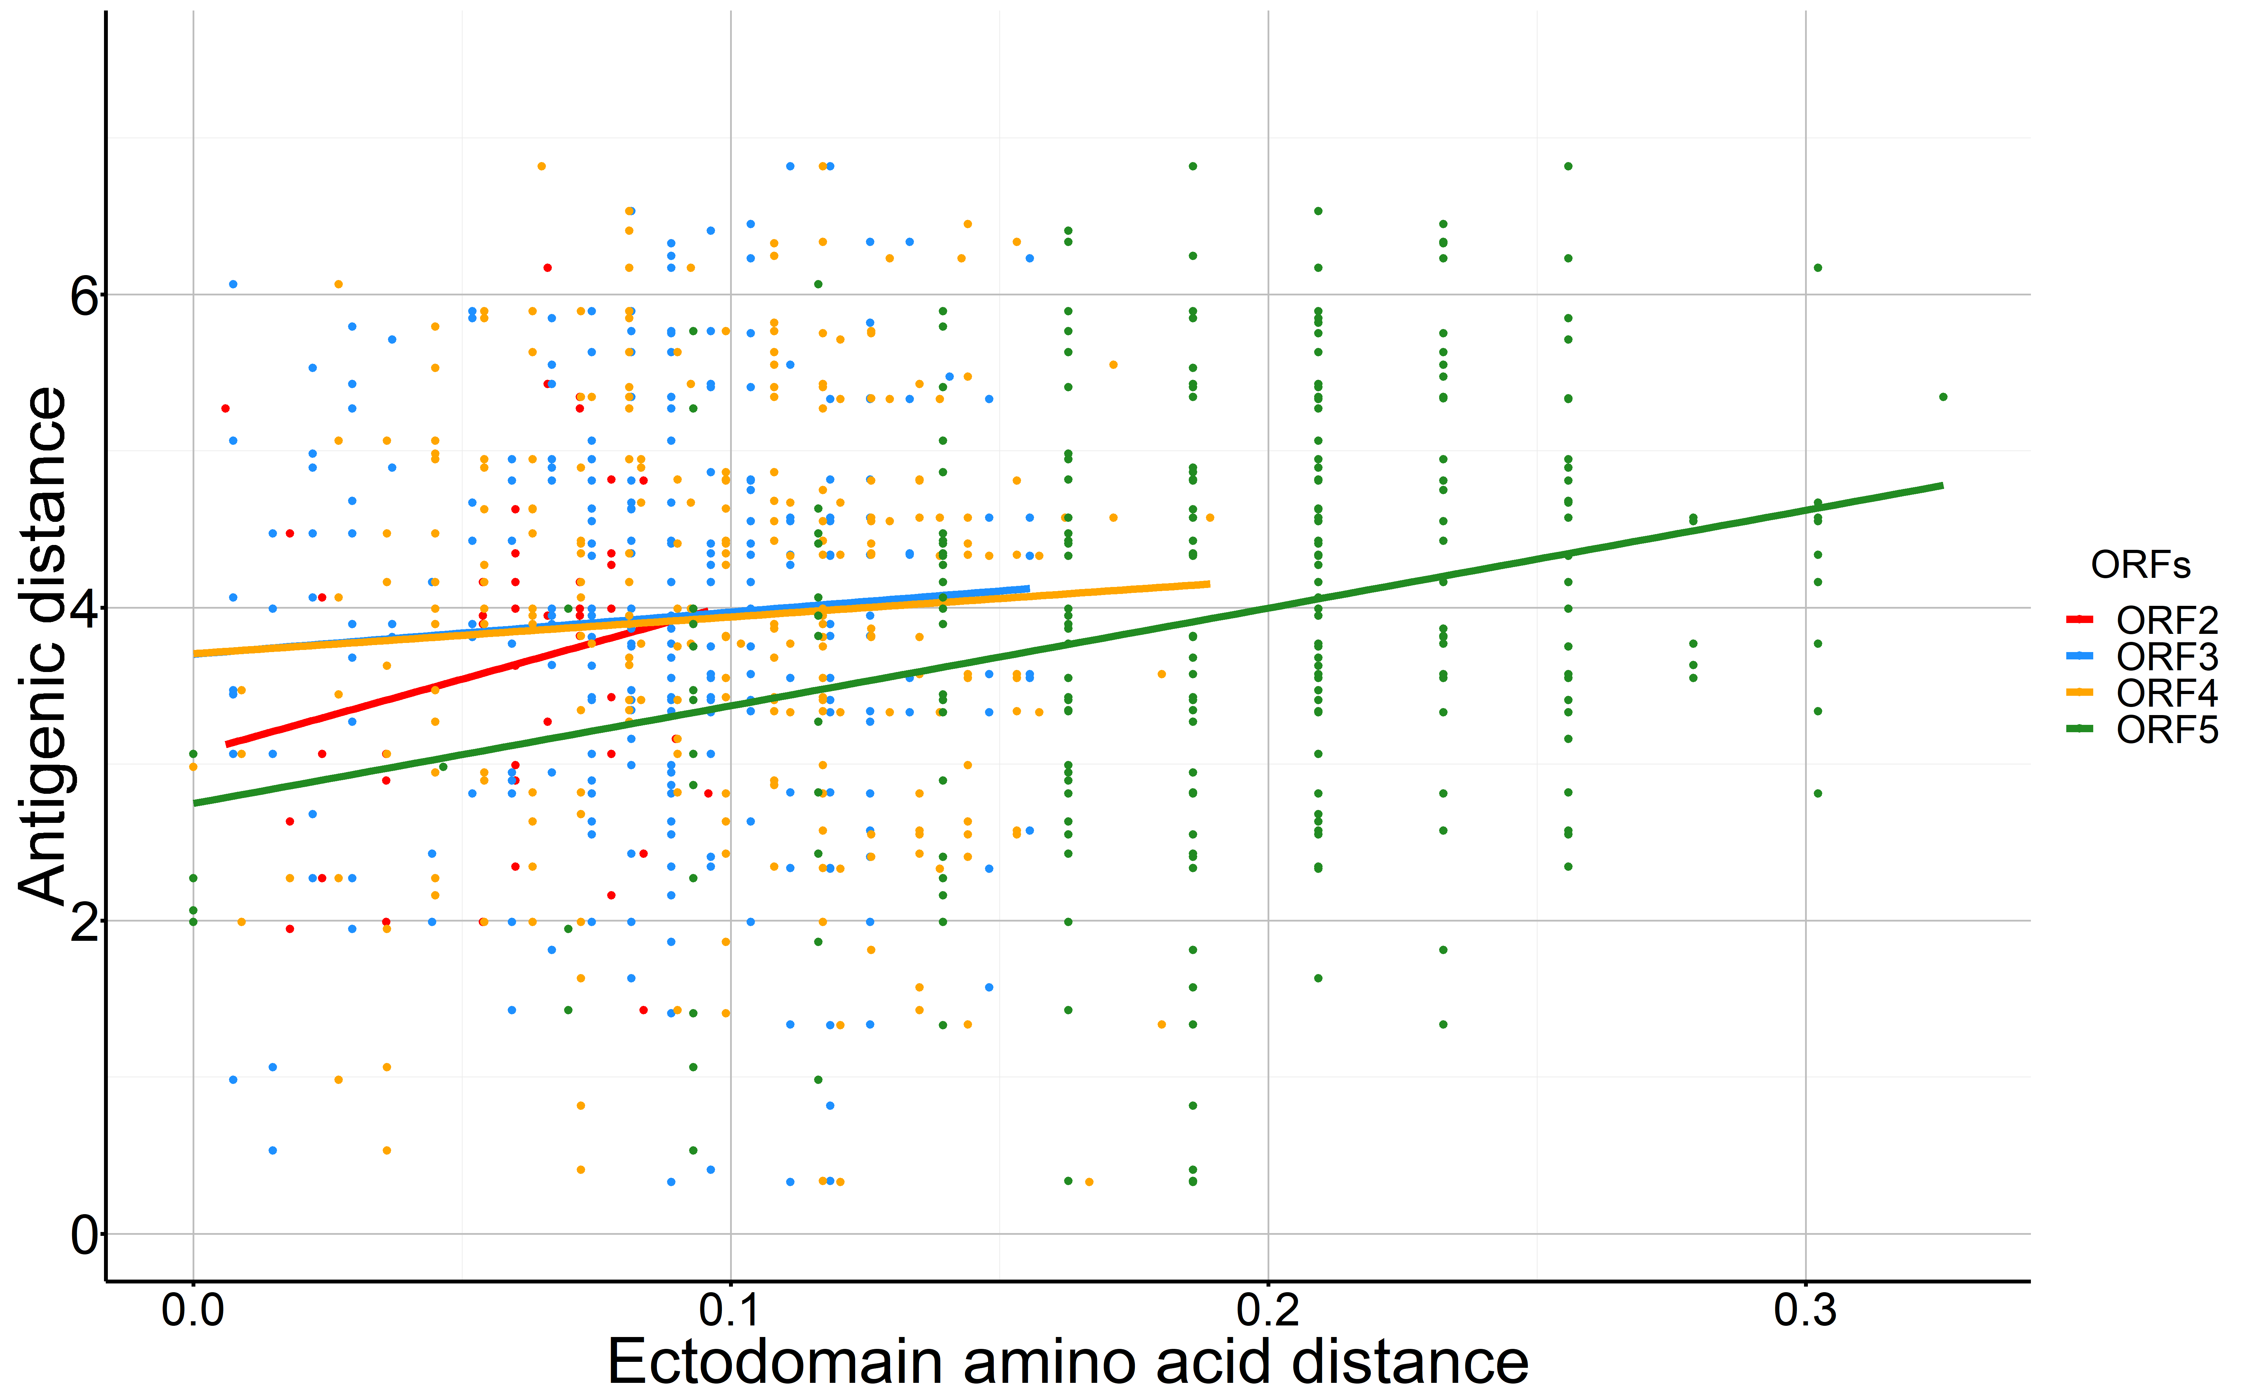
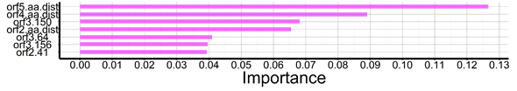
Antigenic difference and amino acid distance are correlated
Part 5: Estimating antigenic differences
ORF5: Strongest correlation between ectodomain aminoacid distance and antigenic difference
ORF2 - 0.16 (p=0.25)
ORF3 - 0.03 (p=0.56)
Our ability to estimate high vs low antigenic difference:
Se: 86%
Sp: 75%
Variables that contributed the most to the performance of the model:
ORF5, ORF4 and ORF2 aminoacid distance between samples
Aminoacids on specific sites
Makau
ORF4 - 0.04 (p=0.49)
ORF5 - 0.25 (p < 0.001)
PPV: 80%
NPV: 82%
Antigenic difference
Accuracy: 81%
Estimating PRRS antigenic differences based on genetic sequences seems to be possible
Notes:
And we do have interesting findings on that front. First, we measured the correlation between the antigenic difference between PRRSV strains and the ectodomain amino acid distance of these strains. We had access on not only the ORF5 of the PRSSV genome, but still, we found a greater correlation between the antigenic difference and the aminoacid distance on ORF5. Our trained model was able to adequately estimate high vs low antigenic difference quite accurately: 86% sensitivity, 80% positive predictive value, 75% specificitiy, 82% negative predictive value, for an accuracy of 81%. That’s a respectable performance. We can ask our model what variables contributed the most to the performance of the model, and the variable that contributed the most to the predictions was the plain AA distance on the ORF5 between samples, followed by the genetic distance on ORF4, ORF2 and on the aminoacid composition on specific sites. Let me show a bit more data on this.

Slide 16
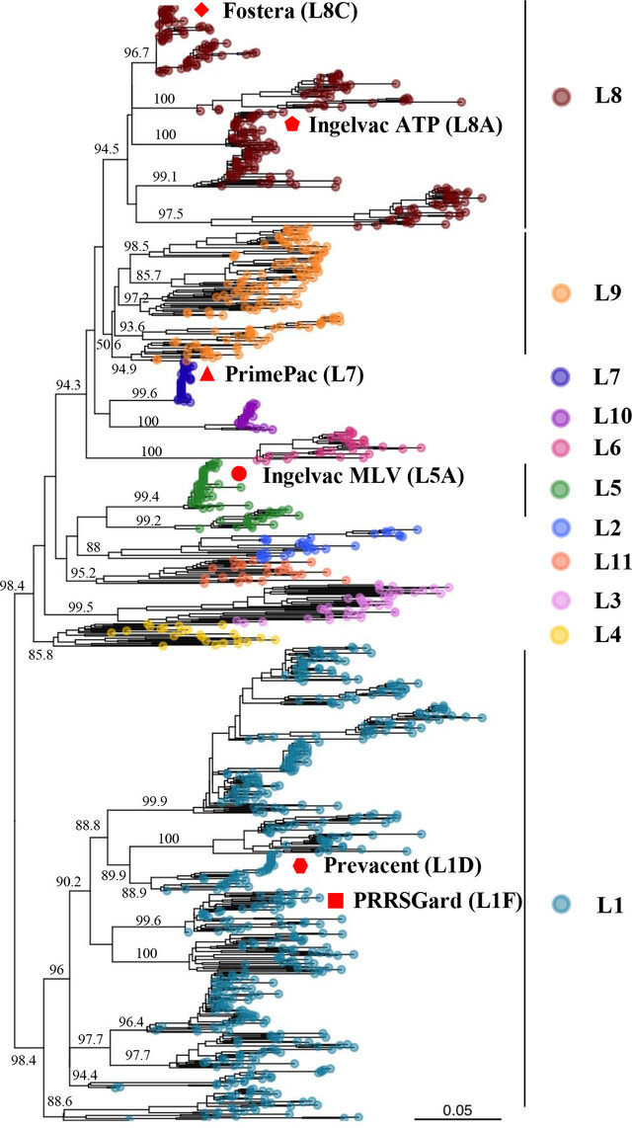
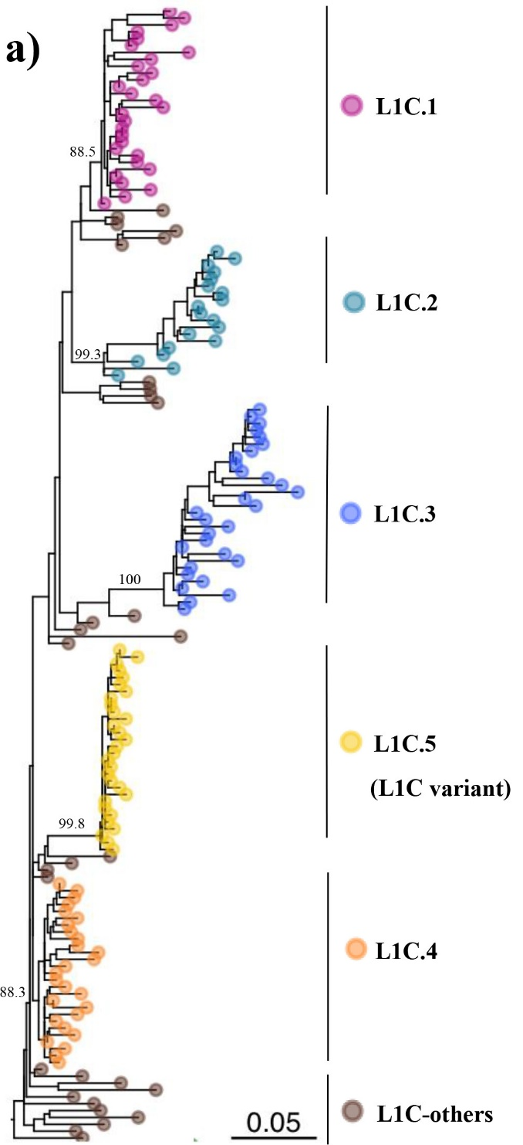
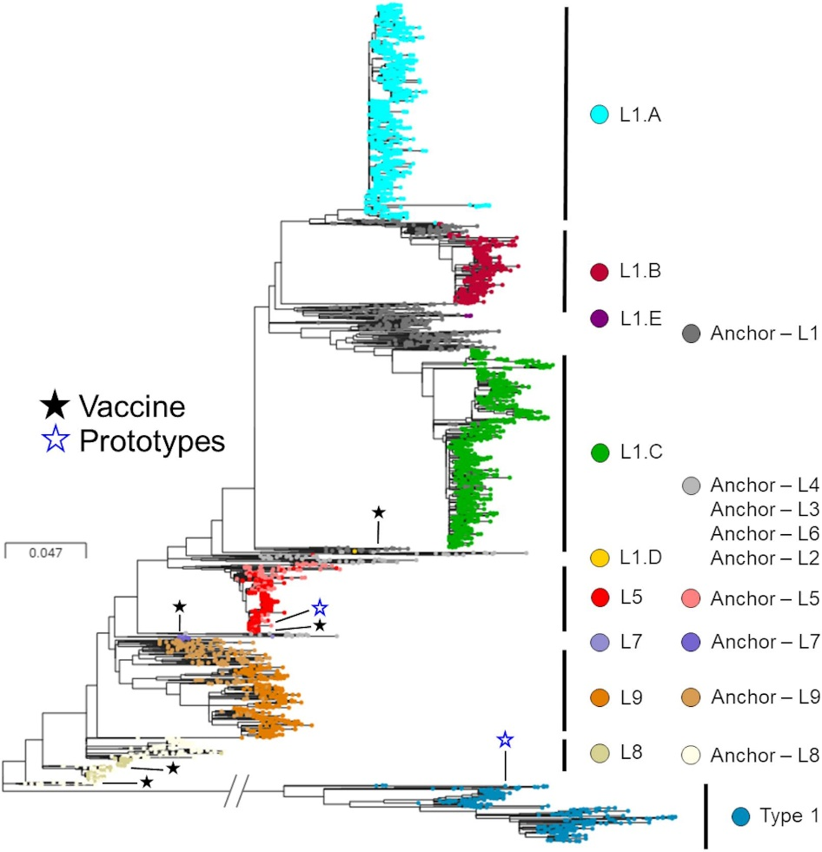
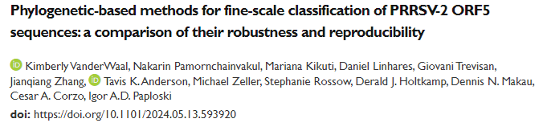
Finer scale classification scheme for PRRSV
Part 6: Variants of PRRSV
Ongoing effort to classify PRRSV into smaller phylogenetic groups: variants
More useful for farms:
Better relatedness ascertainment of viruses

Slide 17
Closing thoughts
Part 5: Closing thoughts
PRRSV is a diverse pathogen and it continues to diversify
Finer-scale classification scheme is starting to be used (UMN VDL is reporting variants)
Emergence of PRRSV variants may be associated with changes in antigenic sites
Indicators that allow estimation of the emergence potential of a PRRSV clade seem to exist
Estimation of antigenic differences between PRRSV sequences seems to be possible
Does that translate to cross-protection in vivo?
We may be approaching a point in which we will be able to
leverage this to better manage immunity at a farm level
Notes:
So, with that, those are my closing thoughts for this presentation.
The frequency of glycosylation patterns of PRRSV change over time, and the emergence of PRRSV variants seem to be associated in antigenic sites.
We think that indicators that allow the estimation of the emergence potential of PRRSV clades seem to exist, and this matters because this may allow us to anticipate what the “next big wave” of PRRSV might be. That’s crucial for the industry, particularly taken together with the next point, in which
We think that the estimation of antigenic differences between PRRSV is possible. We still have many questions to address, such as if our estimated antigenic difference translate to cross-protection in vivo, and don’t take me wrong, I don’t wanna overstate our findings here. There are many challenges that still need to be overcome, but we think that we may be approaching a point in which we will be able to leverage this knowledge to better manage immunity at a farm level.

Slide 18



Thank you!
Acknowledgements:
UMN Vet. Diagnostic Laboratory
MSHMP Participants & Team
EEID PRRS team
Declan Schroeder
Albert Rovira
Maxim Cheeran
Cesar Corzo
Samantha Lycett
Rowland Kao
Andrea Doeschl-Wilson
ipaplosk@umn.edu
Our lab website
Our lab:
Kimberly VanderWaal
Dennis Makau
Nakarin Pamornchainavakul
Julia Baker
João Herrera
Notes:
With that, I’d like to thank you all for watching this presentation, for the Leman Conference for the opportunity to be here and share the exciting things that we are doing. As I mentioned in the beginning of the presentation, this presentation shows efforts of many different people from our lab. Let me specifically mention Kimberly VanderWaal, the PI of our lab, Dennis Makau, Nakarin pamorchainavakul and Julia baker. I’d also like to acknowledge our collaborators and particularly our funding agencies, The Swine Health Information Center (SHIC), the national science foundation (NSF) and the USDA/NIFA.
Thank you very much.

